Slide 1
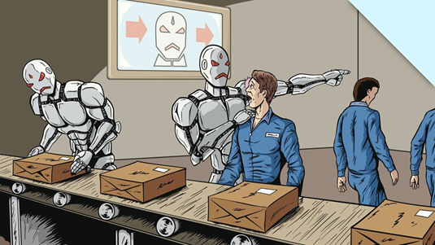
Will artificial intelligence (ai) take our jobs away ?
ARTIFICIAL INTELLIGENCE IS INTELLIGENCE DEMONSTRATED BY MACHINES, AS OPPOSED TO THE NATURAL INTELLIGENCE DISPLAY BY HUMANS OR ANIMALS. SOME POPULAR ACCOUNTS USE THE TERM “ARTIFICIAL INTELLIGENCE” TO DESCRIBE MSCHINES THAT IMITATE COGNITIVE FUNCTIONS OF THAT HUMANS ASSOCIATE WITH THE HUMAN MIND SUCH AS LEARNING AND PROBLEM SOLVING.

Slide 2
ArtificaIl intelligence in the workplace: what is at stake for workers?
WORKERS HAVE ALWAYS FACED WORKER TRACKING AND PERFORMANCE MONITORIG WHERE AN OVERARCHING BUSINESS PROFIT MOTIVE DOMINATES THE TERM OF THE EMPLOYMENT RELATIONSHIP, AND WORKERS WANT A DECENT AND ENJOYABLE LIFE, PAID FOR BY THEIR EMPLOYER AND WAGE PROVIDER. TODAY, HOWEVER, THE EMPLOYMENT RELATIONSHIP IS CHANGING AND THERE IS A NEW TYPE OF ACTOR IN THE WORKPLACE. MACHINES, BOTH ANALOG AND DIGITAL, HAVE BEEN USED OVER TIME TO HELP WORKPLACE DESIGNERS CALCULATE OUTPUTS OF WORK AND, INDEED, TO REPLACE WORK THROUGH AUTOMATION, NOW , VIA THE INTEGRATION OF ARTIFICIAL INTELLIGENCE TOOLS AND APPLICATIONS, SOME MACHINES HAVE NEW RESPONSIBILITIES AND EVEN AUTONOMY, AS WELL AS BEING EXPECTED TO DISPLAY VARIOUS FORMS OF HUMAN INTELLIGENCE AND MAKE DECISION ABOUT WORKERS THEMSELVES.

Slide 3
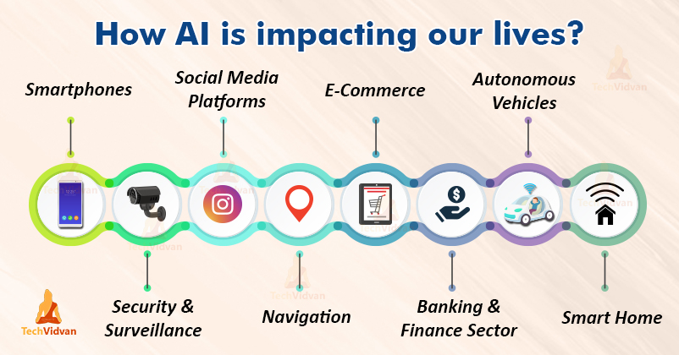

Slide 4
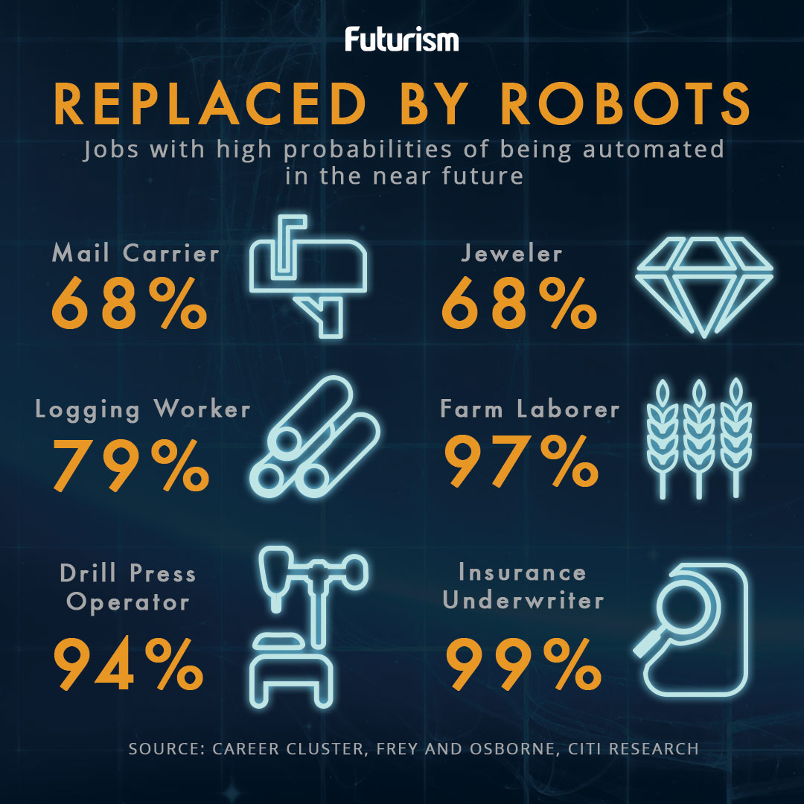

Slide 5
SOURCES
https://en.m.Wikipedia.org/wipi/artificial-intelligence
https://www.bbvaopenmind.com ARTIFICIAL INTELLIGENCE IN THE WORKPLACE
https://builtin.com The Future Of AI: How Artificial Intelligence Will Change the World
https://news.usc.edu
https://www.forbes.com

